Slide 1
CSE5095-002: Topics in Software Defined Networking
Lecture 6
Minmei Wang
Computer Science and Engineering

Slide 2
Forwarding Metamorphosis: Fast Programmable Match-Action Processing in Hardware for SDN Pat Bosshart, Glen Gibb, Hun-Seok Kim, George Varghese, Nick McKeown, Martin Izzard, Fernando Mujica, Mark Horowitz Texas Instruments, Stanford University, Microsoft

Slide 3
Outline
Conventional switch chips are inflexible
SDN demands flexibility…sounds expensive…
How do we do it: The RMT switch model
Flexibility costs less than 15%

Slide 4
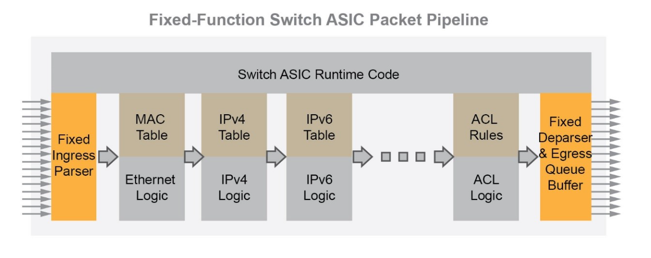
Fixed function switch

Slide 5
What if you need flexibility?
Flexibility to:
Add a new header field
Specify the number, topology, widths, and depths of match tables
Add a new table
Add a different action
......
SDN accentuates the need for flexibility
Gives programmatic control to control plane, expects to be able to use flexibility

Slide 6
What does SDN want?
Multiple stages of match-action
Flexible allocation
Flexible actions
Flexible header fields

Slide 7
What We Set Out To Learn
How do I design a flexible switch chip?
What does the flexibility cost?
Balance the flexibility and speed

Slide 8
Outline
Conventional switch chip are inflexible
SDN demands flexibility…sounds expensive…
How do we do it: The RMT switch model
Flexibility costs less than 15%

Slide 9
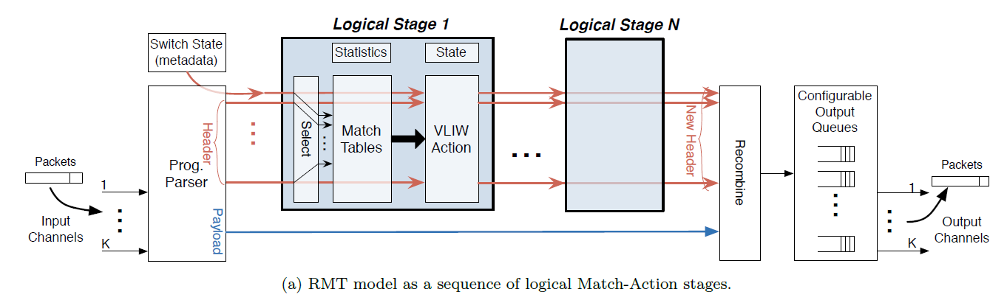
RMT model
Very long instruction word (VLIW): instruction set architectures designed to exploit instruction level parallelism (ILP)

Slide 10
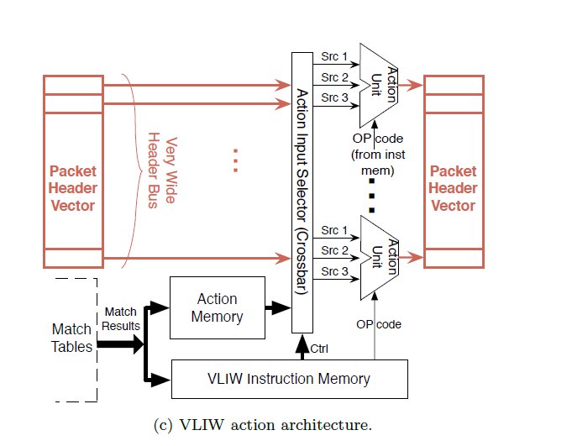
RMT model
Very long instruction word (VLIW): instruction set architectures designed to exploit instruction level parallelism (ILP)

Slide 11
The RMT Abstract Model
Parse graph
Table graph

Slide 12
Arbitrary Fields: The Parse Graph
Packet:
Ethernet IPV4 TCP
Ethernet
EtherType
IPV4
IPV6
protocol
TCP
UDP

Slide 13
Arbitrary Fields: The Parse Graph
Packet:
Ethernet IPV4 TCP
Ethernet
IPV4
TCP
UDP

Slide 14
Reconfigurable Match Tables: The Table Graph
VLAN
ETHERTYPE
MAC
FORWARD
IPV4-DA
IPV6-DA
ACL
RCP

Slide 15
Changes to Parse Graph and Table Graph
Ethernet
ETHERTYPE
VLAN
VLAN
IPV4
IPV6
L2S
IPV4-DA
IPV6-DA
RCP
L2D
RCP
TCP
UDP
ACL
Done
MY-TABLE
Parse Graph
Table Graph

Slide 16
Performance V.S. Flexibility
Change to pipeline
Fixed function chips specialize processors
Flexible switch needs general purpose CPUs

Slide 17
How We Did It
Memory to CPU bottleneck
Replicate CPUs
More stages for finer granularity
Higher CPU cost ok
CPU
CPU
CPU
C
P
U
CPU
CPU
Memory
C
P
U
CPU
CPU
C
P
U
CPU
CPU

Slide 18
RMT Logical to Physical Table Mapping
Physical
Stage 1
Physical
Stage 2
Physical
Stage n
ETH
3
IPV4
9 ACL
VLAN
TCAM
L2S
IPV4
IPV6
2
VLAN
5
IPV6
Match Table
Match Table
Match Table
640b
Action
Action
Action
L2D
TCP
UDP
4
L2S
7 TCP
SRAM
HASH
ACL
8 UDP
Logical Table 6
L2D
Table Graph
Logical Table 1
Ethertype
640b
Notes:
To make it possible to efficiently use multiple stages of match tables, it is assumed that the RMT Model can be configured to map Logical Tables to the Physical Tables.
To create bigger tables, one table may traverse multiple stages.
To create many smaller tables, several tables can be packed into one stage.
To make the allocation even more flexible, the Action instructions and the Statistic could share the same table space.
This slide gives a crude representation of how the the Logical Tables could be mapped to the Physical Tables.
In practice, the control plane would need to create a Table Flow Graph (to accompany the Parse Graph) to decide how the Logical Tables are mapped.
The control plane is assumed to know the number and size of the physical stages available.
There could be as few as 1 stage. A given switch might only allow Logical Tables to directly correspond to Physical Tables.

Slide 19
TCAM
Ternary content-addressable memory
A specialized type of high-speed memory that searches its entire content sin a single clock cycle
Three states: 0,1, X (don’t care)
Entry: data & mask
Support arbitrary lookup key
E.g., 10XX0

Slide 20
Action Processing Model
Field
Header In
Header Out
ALU
Field
Data
Match result
Instruction
Notes:
Action processing is assumed to be available in each physical stage of the pipeline.
The headers are available along with the match result and metadata. Optional state could be available to the Action Processors.
There are assumed to be some number of processors (could be 1, could be hundreds) to perform Actions on headers.
The Action instruction set is assumed to be protocol independent (e.g. “insert these 8 bits starting at bit 19 of the 3rd header”).

Slide 21
Modeled as Multiple VLIW CPUs per Stage
ALU
ALU
ALU
ALU
ALU
ALU
ALU
ALU
ALU
Match result
VLIW Instructions

Slide 22
Our Switch Design
64 x 10Gb ports
960M packets/second
1GHz pipeline
Programmable parser
32 Match/action stages
Huge TCAM: 10x current chips
64K TCAM words x 640b
SRAM hash tables for exact matches
128K words x 640b
224 action processors per stage
All OpenFlow statistics counters

Slide 23
Outline
Conventional switch chip are inflexible
SDN demands flexibility…sounds expensive…
How do I do it: The RMT switch model
Flexibility costs less than 15%

Slide 24
Cost of Configurability: Comparison with Conventional Switch
Many functions identical: I/O, data buffer, queueing…
Make extra functions optional: statistics
Memory dominates area
Compare memory area/bit and bit count
RMT must use memory bits efficiently to compete on cost
Techniques for flexibility
Match stage unit RAM configurability
Ingress/egress resource sharing
Table predication allows multiple tables per stage
Match memory overhead reduction
Match memory multi-word packing

Slide 25
Chip Comparison with Fixed Function Switches
Area
Section | Area % of chip | Extra Cost
IO, buffer, queue, CPU, etc | 37% | 0.0%
Match memory & logic | 54.3% | 8.0%
VLIW action engine | 7.4% | 5.5%
Parser + deparser | 1.3% | 0.7%
Total extra area cost |  | 14.2%
Power
Section | Power % of chip | Extra Cost
I/O | 26.0% | 0.0%
Memory leakage | 43.7% | 4.0%
Logic leakage | 7.3% | 2.5%
RAM active | 2.7% | 0.4%
TCAM active | 3.5% | 0.0%
Logic active | 16.8% | 5.5%
Total extra power cost |  | 12.4%

Slide 26
Conclusion
How do we design a flexible chip?
The RMT switch model
Bring processing close to the memories:
pipeline of many stages
Bring the processing to the wires:
224 action CPUs per stage
How much does it cost?
15%
Lots of the details how we designed this in 28nm CMOS are in the paper

